Slide 1
Synchronization

Slide 2
Introduction
Multiple concurrent threads ‘tasks’ of execution within an application must be able to synchronize their execution and coordinate mutually exclusive access to shared resources.
To address these requirements, RTOS kernels provide a semaphore object and associated semaphore management services.

Slide 3
Semaphore (general)
A semaphore (sometimes called a semaphore token) is a kernel object that one or more threads of execution can acquire or release for the purposes of synchronization or mutual exclusion.

Slide 4
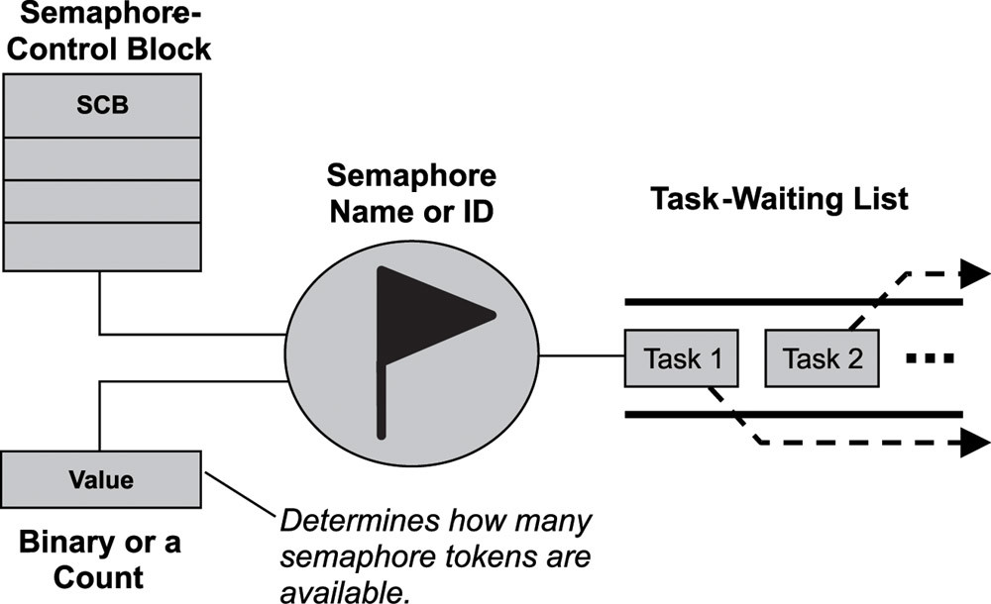
Semaphore (general)

Slide 5
Semaphore (general) Cont.
A semaphore is like a key that allows a task to carry out some operation or to access a resource.
If the task can acquire the semaphore, it can carry out the intended operation or access the resource.
A single semaphore can be acquired a finite number of times.

Slide 6
Semaphore (general) Cont.
A requesting task, therefore, cannot acquire the semaphore, and the task blocks if it chooses to wait for the semaphore to become available.
The task-waiting list tracks all tasks blocked while waiting on an unavailable semaphore.
When an unavailable semaphore becomes available, the kernel allows the first task in the task-waiting list to acquire it.

Slide 7
Semaphore (general) Cont.
The kernel moves this unblocked task either to the running state, if it is the highest priority task, or to the ready state, until it becomes the highest priority task and is able to run.
A kernel can support many different types of semaphores, including binary, counting, and mutual-exclusion (mutex) semaphores.

Slide 8
Binary Semaphores
FreeRTOS APIs
To create binary semaphore:
  SemaphoreHandle_t xSemaphoreCreateBinary( void );
To obtain ‘take’ the semaphore (must not be used from an ISR):
  BaseType_t xSemaphoreTake( SemaphoreHandle_t xSemaphore, TickType_t xTicksToWait );
    Return pdPASS or pdFALSE(xTicksToWait in Blocked State).
To release ‘give’ the semaphore:
  BaseType_t xSemaphoreGiveFromISR( SemaphoreHandle_t xSemaphore, BaseType_t *pxHigherPriorityTaskWoken );
pxHigherPriorityTaskWoken (default pdFALSE) internally set to pdTRUE when (unblocked task has a priority higher than the currently executing task) to ensure context switch should be performed before the interrupt is exited.

Slide 9
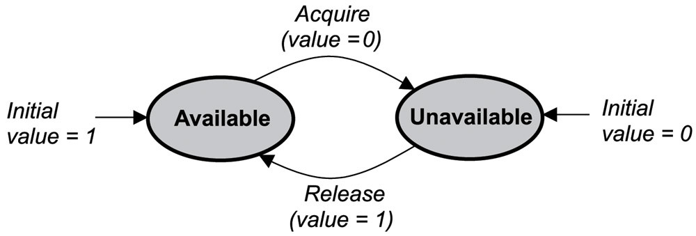
Binary Semaphores (general)
A binary semaphore can have a value of either 0 or 1.

Slide 10
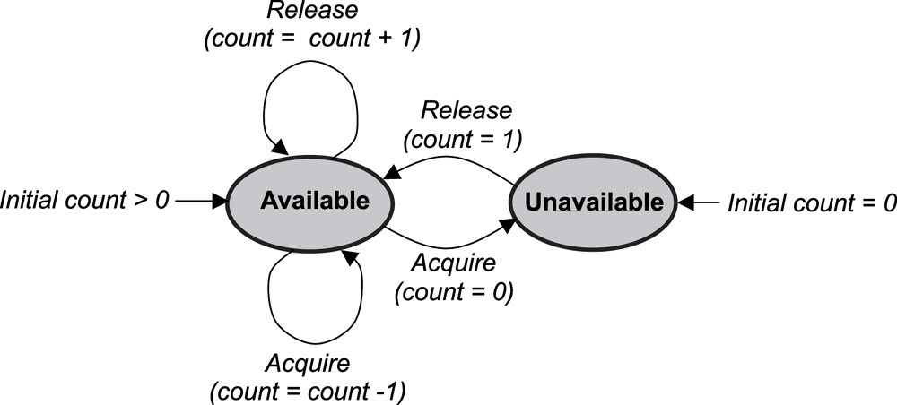
Counting Semaphore (general)
A counting semaphore uses a count to allow it to be acquired or released multiple times.
When creating a counting semaphore, assign the semaphore a count that denotes the number of semaphore tokens it has initially.
If the count is greater than 0, the semaphore is created in the available state, and the number of tokens it has equals its count, as shown in Figure :-

Slide 11
Counting Semaphores
FreeRTOS APIs
To Counting binary semaphore:
  SemaphoreHandle_t xSemaphoreCreateCounting( UBaseType_t uxMaxCount, UBaseType_t uxInitialCount );
When the semaphore is to be used to manage access to a collection of resources, uxMaxCount should be set to the total number of resources that are available.

Slide 12
Critical Sections
A switch to another task cannot occur between the call to taskENTER_CRITICAL() and the call to taskEXIT_CRITICAL().
Critical sections implemented in this way are a very crude method of providing mutual exclusion.
They work by disabling interrupts, either completely, or up to the interrupt priority set by configMAX_SYSCALL_INTERRUPT_PRIORITY— depending on the FreeRTOS port being used.

